Slide 1
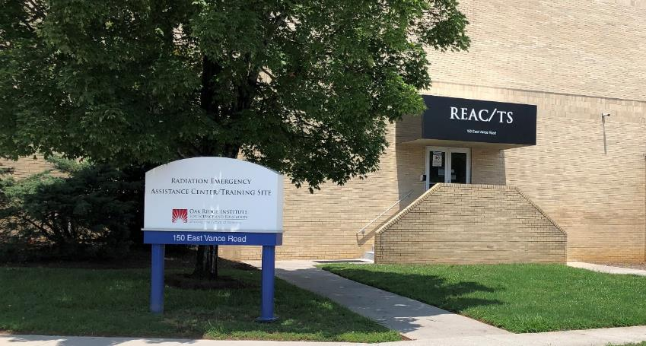
Radiation Biodosimetry: Where we are and where we need to go
Dr. Adayabalam S. Balajee
Director of Cytogenetic Biodosimetry Laboratory
Radiation Emergency Assistance Center/Training Site
Oak Ridge Institute for Science and Education
Oak Ridge Associated Universities
Oak Ridge, TN 37830

Slide 2
Overview
Introduction to Biodosimetry
Advantages of Biodosimetry
Biodosimetry tools
POC Biodosimetry Tools
Current limitations of POC Tools
Future Development and Perspectives
Conclusions

Slide 3
What is Biodosimetry?
* Biodosimetry is a measurement of biological response as a surrogate for radiation dose
* Biological indicators are those that show a measurable response to ionizing radiation
* Bioindicators include macromolecules such as DNA, RNA, proteins and lipids and as well as a wide variety of metabolic byproducts
Bio dosi metry
Live
organisms
Measurement
Radiation
dose

Slide 4
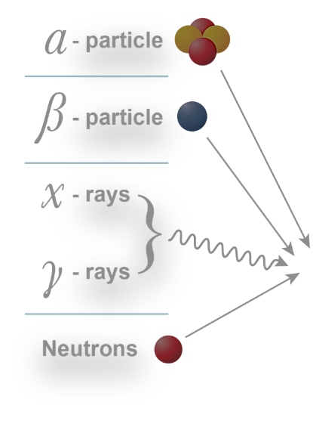

Bioindicators as Predictors of Dose and Health Outcome
Clinical
symptoms
Blood cell
counts
Dose estimation
Molecular
Biomarkers
Immediate
Medical
management
Long-term
monitoring

Slide 5
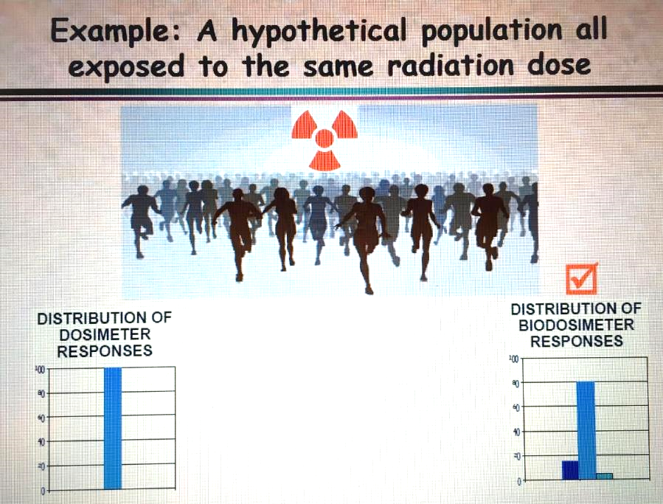
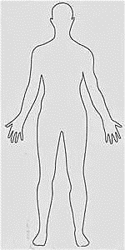
Advantages of Biological Dosimeters
What if the exposure
happens in the back
or in the lower portion
of the body?
Measures dose external
to the body (front side)
What is the exposure dose
inside the body?
What are the long-term
biological effects?

Slide 6
Biodosimetry is essential for medial treatment decision
0 - 2 Gy No treatment
Bone
marrow
depression
2 Gy - 7.5 Gy
Antibiotics/Transfusions/Nursing
2 Gy - 10 Gy
Cytokine therapy
7.5 Gy - 10 Gy
Bone marrow transplantation
10 Gy - >13 Gy
GI death
LD 50/60 3.5-4 Gy (without treatment)
LD50/60 7-8 Gy (with antibiotics and nursing)
All doses refer to photons

Slide 7
Situations Requiring High-Throughput Radiation Biodosimetry
Radiation Dispersal Device (RDD)
Improvised Nuclear Device (IND)
Radiological Terrorism
Depending on scenario, hundreds and thousands may be exposed
High throughput platforms are needed for rapid biodosimetry

Slide 8

Which biodosimeter(s) will be effective as a triage tool?
< 2Gy
Go Home
Large-scale Rad/Nuc incidents
Long-term
monitoring
POC
Triage
> 2Gy
Medical intervention

Slide 9
Current Biodosimetry Tools
DCA
CBMN
PCC
MN-BE
γ-H2AX
Novel markers
(Microvesicles?
Exosomes?)
Biodosimetry
tools
EPR
LDR
Transcriptomics
Proteomics
Genomics
Metabolomics
miRNA
mRNA

Slide 10
Most used biodosimetry tools
Time to emesis
Lymphocyte depletion kinetics
Electron paramagnetic resonance (EPR)
Gene expression
Dicentric Chromosome Assay
Cytokinesis Blocked Micronucleus assay

Slide 11
Potential Biodosimeters for POC
(Total Assay Time)
Time to emesis Self reporting
Lymphocyte depletion kinetics 5 min
(must be repeated a few times)
Electron paramagnetic resonance 5min
(EPR)
Gene expression 4-7 hours

Slide 12
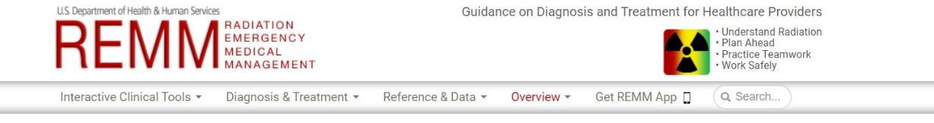
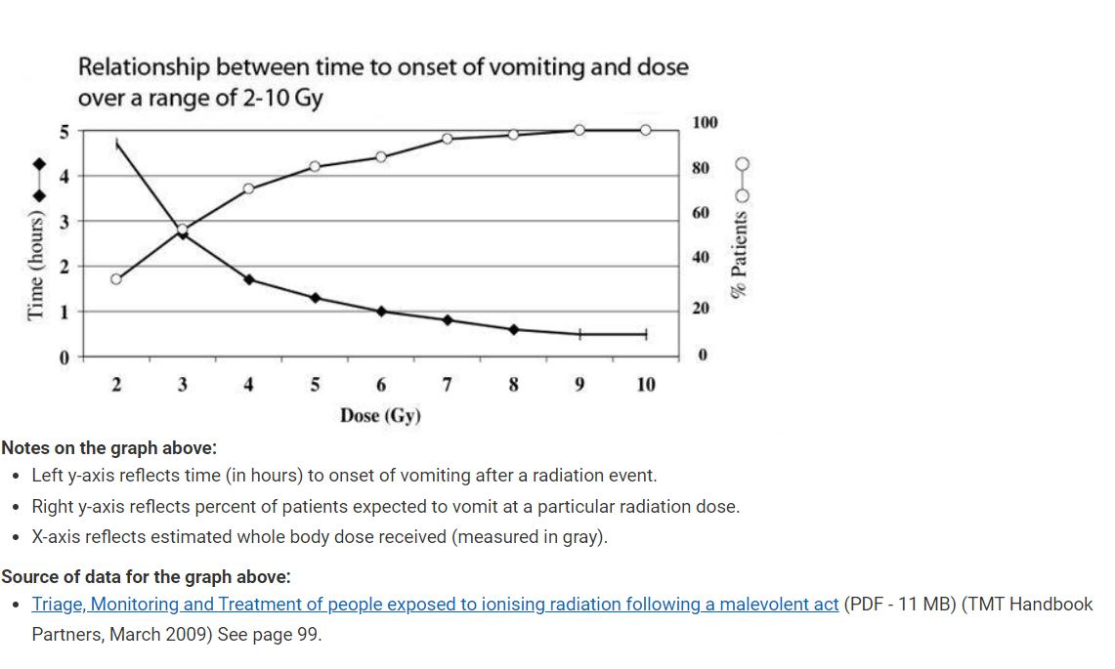
Biodosimetry
Assessment
Tool (BAT)- AFRRI

Slide 13
EMESIS
Advantages Disadvantages
* Self reporting
* No equipment
* Capable of identifying
severely exposed group (> 2Gy)
* Potentially useful for higher doses with an early onset of emesis before 30 min or less
* Provides evidence of ARS
* May not be specific for radiation
* Can be due to psychosomatic illness
* Dose prediction error is 200% (less than 10% is acceptable) for low doses
* Asymptomatic people
without emesis
* False positive rate increases with increasing time for emesis

Slide 14
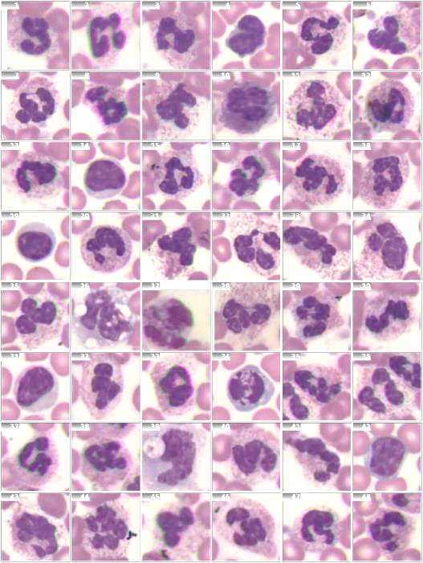
Lymphocyte Depletion Kinetics
Blood collection
Count lymphocytes
Cell counts
Feed the data to BAT
Radiation dose (Gy)
Dose estimation
using the algorithm

Slide 15
Whole blood cell counts
Advantages Disadvantages
Total assay time is a few minutes per sample
High throughput capability
Most useful for clinicians for appropriate therapeutic strategies
Highly relevant for ARS
Radiation specific diagnostic tool
Decline of 50% lymphocytes
Within 12 hours indicates a significant radiation dose( >3 Gy whole body dose)
Variable blood cell counts
among individuals
• Base line data not available for comparison
Multiple collections are required up to 3 times per day
Time consuming and challenging for triage

Slide 16
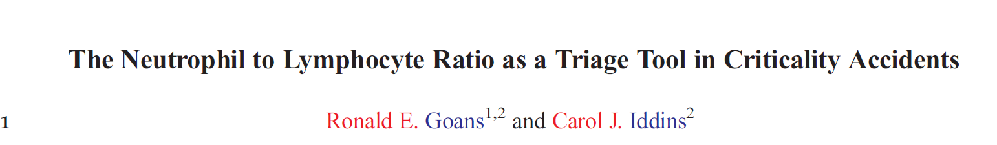
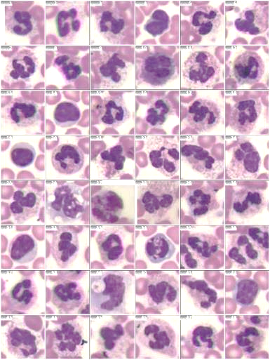
Usefulness of neutrophil and lymphocyte ratio has been evaluated for triage
using the radiation accident registry at REAC/TS.
Health Phys. 2021 Apr 1;120(4):410-416. doi: 10.1097/HP.0000000000001342.
Neutrophil
Lymphocyte

Slide 17
Electron Paramagnetic Resonance (EPR) and
Electron Spin Resonance (ESR)
* Methods to study materials with radiation induced unpaired electrons. These
include free radicals.
* These methods detect the transitions of unpaired electrons with an externally
applied magnetic field.
Tooth enamel
Fingernails
Toenails
Bone biopsies
Dose reconstruction in Chernobyl victims
Mayak worker cohort
575 research articles in PubMed;
Search terms: EPR and dosimetry

Slide 18
EPR and ESR
Useful for partial and total body irradiation scenarios
The assays are free of many confounding factors such as radiation sensitivity
EPR has a dose response linearity up to 30Gy
Sensitive to X-rays, γ-rays and internal contamination (insensitive to dose rate)
Used for dose reconstruction in A-bomb survivors, Chernobyl and the Techa River region
These assays are insensitive to biological processes and therefore they should be used in conjunction with other biodosimetry methods
EPR and ESR can be used as the first layer of triage
Field deployable and is ranked at 4B
A single EPR unit can screen 275 people per day
Further refinement of fingernail EPR will advance its utility for mass casualty screening
Sensitivity is not high for doses less than 1 Gy. Background noise is high
sometimes. It dose not provide clinically relevant information.

Slide 19
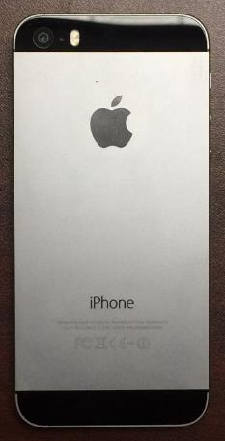
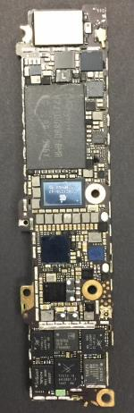
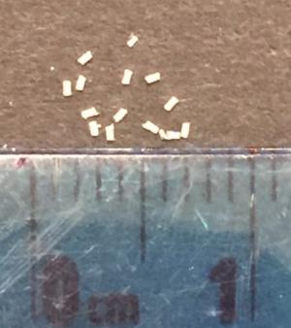
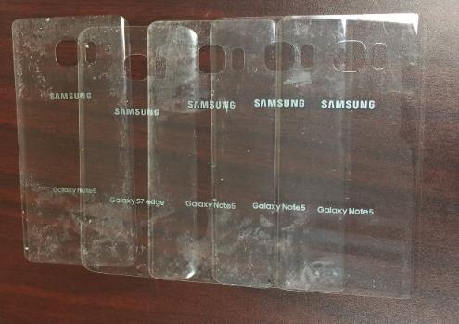
REAC/TS Collaborative Research Project
Use of smartphones as potential dosimeters for
radiological/nuclear triage
Back glasses will be used
as extra emergency
dosimeters
Resistors
Surface mount resistors
Dr. Sergey Sholom, OSU
Dr. Steve McKeever, OSU
Dr. Adayabalam Balajee (REAC/TS)

Slide 20
Comparison of Smartphone Dosimeters with
Reference Dosimeters by EPR
Cell phone DCA
Physical Dose (Gy)
J. Radiol. Prot. 42 (2022) 021515 https://doi.org/10.1088/1361-6498/ac5815 A comparative validation of biodosimetry and physical dosimetry techniques for possible triage applications in emergency dosimetry
Delivered Dose (Gy)

Slide 21
Transcriptomics
(mRNA and miRNA)
Nucleus
(~25,000 genes)
Increase
Decrease
Expression
0 Gy 5 Gy
0 Gy 5 Gy
Decreased Increased
The identified genes can serve as markers for predicting radiation dose

Slide 22
Radiation Responsive Genes Selected for Absorbed
Radiation Dose Prediction
Radiation Responsive
Genes
Downregulated
Genes
MYC
PARP1
TRIB2
Normalizer Genes
Bax
Bax
BBC3
CDKN1A
DDB2
DEDD
LAPTM5
PCNA
CDR2
MRPS18A
MRPS5
Jacobs et al. (2020) Role of a high throughput biodosimetry test in treatment prioritization after a nuclear incident, International Journal of Radiation Biology, 96:1, 57-66.

Slide 23
Validation in a wide range of human demographics
Race/Ethnicity
African American 114 (F-34, M-80)
Asian 20 (F-9, M-11)
Caucasian 426 (F-184, M-242)
Hispanic 79 (F-33, M-46)
Native American 17 (f-9, m-8)
Confounding factors
Chronic conditions 225
Burn 44
Influenza 14
Trauma 48
Jacobs et al. (2020) Role of a high throughput biodosimetry test in treatment prioritization after a nuclear incident, International Journal of Radiation Biology, 96:1, 57-66.

Slide 24
Other Developments
Bundeswehr Institute of Radiobiology, Munich, Germany
The German group identified a panel of 29 genes that can predict
late occurring hematological acute radiation syndrome in baboons
A panel of 4 genes for hematological ARS- DDB2, FDXR, POU2AF1
and WNT3 (Drs. Matthias Port and Michael Abend)
FDXR gene seems to be very promising for ARS categorization
(mild, moderate and severe)
RadTox test-Circulating free DNA- a potential triage tool (Dr. Paul
Okunieff, University of Florida Health Cancer Center)

Slide 25
Gene expression signatures
Advantages
Disadvantages
Total assay time is 7 hours
Potential for POC testing for triage
Minimally invasive
Process 600 samples in 24 hrs per instrument
High specificity and sensitivity for doses relevant for therapeutic care of people with ARS
DNA repair efficiency
Inherent radio sensitivity
Immune compromised people
Dose rate effects not examined
May not predict health outcome
May not be sensitive for chronic low dose exposure
Needs clinical validation

Slide 26
Scoring Rubric for Biodosimetry Field Phase of Development
Investigative phase
In vitro/ex vivo
radiation model (1)
Murine in vivo
Model (2)
Early Development
phase
Non-human Primate in vivo model (3)
Late Development
phase
Human clinical trials (4A)
Human exposure study (4B)
Deployment ready
FDA approval (5)
Modified from Sproull et al., Radiat. Res. 186, 423-435, 2016.

Slide 27
Transcriptomics (4A) Proteomics (4B) Metabolomics (4B)
Mouse (TBI; 1-8Gy) C-reactive protein (ARS) NHPs (TBI) urine
miR-200b Serum amylase 13 metabolites
miR-762 (Dose dependency) (2-10Gy)
miR-150* (LDK) 55 proteins- human cells Humans (TBI) urine
miR-34a NHPs Metabolites of fatty
TBI with hemorrhage CRP, SAA, Flt3 Ligand acid β oxidation and
miR-29b IL-6, and amylase in PB purine catabolism
miR-30e Human saliva (TBI) Mouse, NHP and Hu
Let-7e IL-8, MCP-1, ICAM-1 Increased expression
Humans Head and Neck CP of taurine and xanthine
Few studies IL-4, IL-6, IL-8, EGF,
No dose dependency VEGF, MCP-1 and TNF-α
Needs clinical validation Potential for POC Field deployable (?)

Slide 28
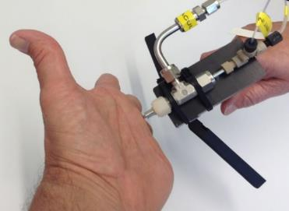
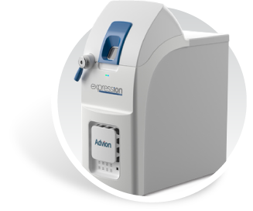

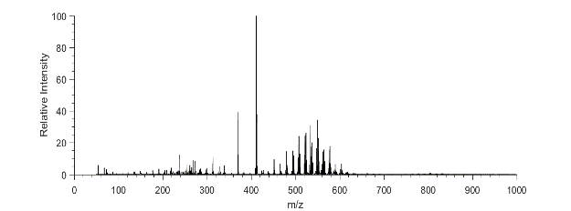
PENDOC SYSTEM FOR METABOLOMICS
Pen-like touch-based system of sampling
Chemical readout by mass spectrometry
On-line chemical analysis software
foolproof sampler touched to material of interest
Lyso-PCs
Many cosmetic compounds
PenDoc is most sensitive to:
  Phospholipids (PC, PE, PI, LysoPC, etc.)
  Acids (amino acids, fatty acids, etc.)
  Drugs and other metabolites (caffeine, acetaminophen, etc.)
  In general, small mass (<1000 Da) polar
  molecules
Amino acids
Fatty acids
PC’s, PE’s, DG’s, etc.
Example Mass Spectrum
From Skin (Finger)
Collaborative work with Dr. Cahill at Oak Ridge National Laboratory

Slide 29
Collaborative Research Project with Ohio State University
MiRNAs are small non-coding RNAs that control gene regulation
There are approximately 2,300 miRNAs
MiRNAs can be detected in blood plasma and serum samples
MiRNAs are modulated by radiation exposure
Differential expression of MiRNAs can be useful as biodosimeters
MiRNA can provide useful information on organ/tissue specific injury
miR150 can yield information on hematopoietic injury- Relevant for
for ARS
Dr. Naduparambil Jacob and his team has shown the utility of
miR150 dose estimation in mouse, NHPs and humans.

Slide 30
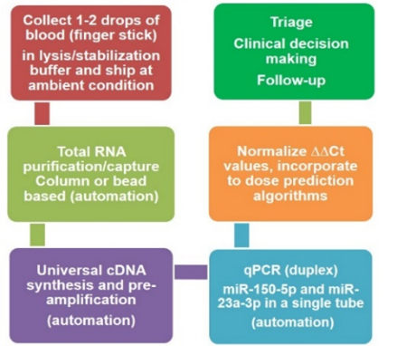
High Sensitivity Radiation Biodosimetry Assay
Minimally invasive: 1-2 drops of blood-finger stick
Internally controlled- not volume/quantity dependent
Broad analytical range: analyte stable from hours to days
Robust response in young, aged- males, females
Samples stored/shipped at ambient conditions
Relatively short processing/assay time
Can be done in a standard molecular biology laboratory
Validated in multiple animal models and humans
Manuscripts and patents: Issued/pending
(US9890428/15-846,96220)
Responsive –miR150
Non-responsive miR23a
Courtesy: Dr. Naduparambil Jacob
Ohio State University

Slide 31
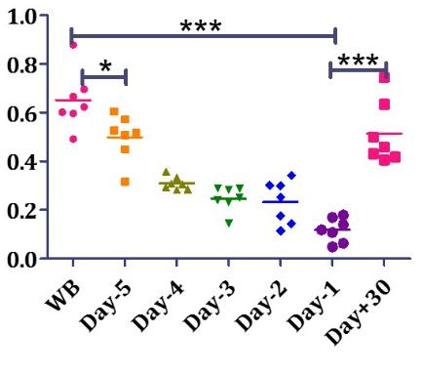
miR-150 Depletion/Reconstitution in Human Acute Myeloid Leukemia patients who received total body irradiation as preparative regimen prior to bone marrow transplantation
Serum
Radiation/BMT Schema
AML
BMT
1200 cGy
(2Gy bid)
Relative Expression
Baseline -6, -5, -4, -3, -2, -1, 0, +30
Clinical Trial: OSU-13219
(PI: Dr. Welliver)
miR-150 assay allows evaluation of marrow depletion and reconstitution
This interesting observation indicates the potential use of this assay for evaluating medical countermeasures (MCM)
Courtesy: Dr. Naduparambil Jacob
Ohio State University

Slide 32
Validation of dose prediction by miRNA with DCA
MicroRNA DCA
2Gy
RBE = 3-4
6Gy
4Gy
1.5Gy
0.75Gy
1Gy
2Gy
0.5Gy
0.5Gy
0.25Gy
0.1Gy
Balajee AS and Jacob NK, unpublished data

Slide 33
miRNA Based Biodosimetry Tool
Advantages
Disadvantages
Total assay time is less than 4 hours after sample collection
Potential for POC testing
Information on tissue specific injury
Holds promise for evaluating medical countermeasures
Early prediction of disease
outcome
• High throughput analysis
Inter-individual variation needs to be verified
Disease status, pre-genetic condition
No data on dose rate effects
Lacks clinical validation
Bridging experiments needed
Reliability and reproducibility

Slide 34
Biomarkers for multiple organ dysfunction syndrome (MODS) after radiation exposure in vivo
Hematopoietic system/Bone marrow aplasia - Flt3-L
Gastrointestinal tract - Citrulline
Liver and Cardiovascular - Oxysterols
Salivary gland - Amylase
Flt3-L has been successively used to distinguish between total and
partial body irradiation in mice

Slide 35
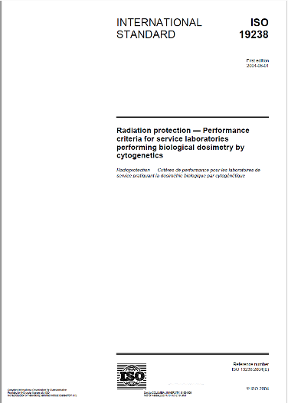
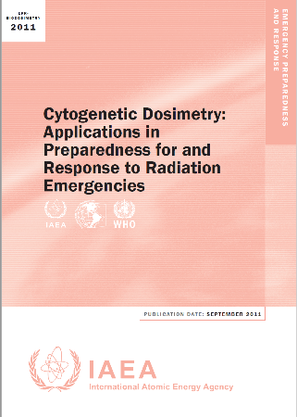
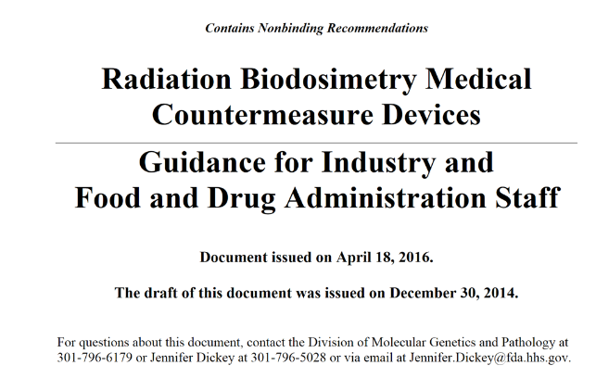
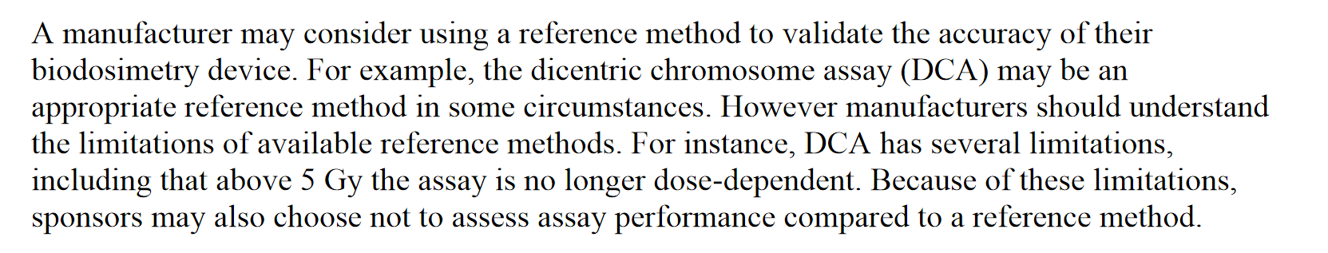
The Dicentric Chromosome Assay
Gold standard for radiation biodosimetry

Slide 36











Dicentric Chromosome Formation
Cells
Mis-repair
Radiation Exposure
Dicentric
Chromosome
DNA
Replication
Breaks in two
chromosomes
Acentric
Fragment
Mis-repair
Since its discovery (1962), the DCA remains as the “gold standard” for absorbed radiation dose estimation

Slide 37
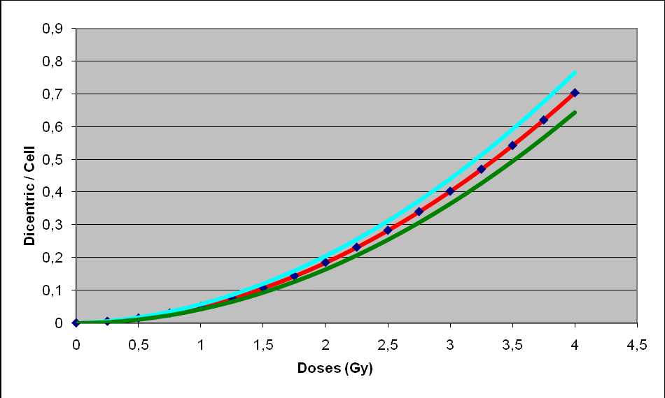
Dicentric Chromosome Assay
Advantages
  Low baseline frequency (1 per 1,000 cells)
  Independent of age and gender
  Ease of detection
  Sensitivity range is
  <= 0.10 to <=7.5Gy
  Reproducible dose response
  Specific for radiation exposure
  Proven in accidents over four decades
95% UCL
95% LCL
TAT 3-4 days
Impractical for triage
application
Automation of high-throughput techniques for sample processing, imaging and analysis is critical for meeting the requirements of a radiological/nuclear mass casualty event.

Slide 38
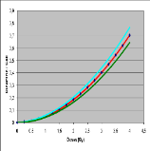
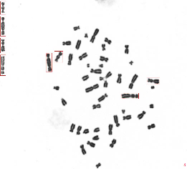
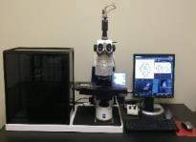
Scheme for Automated high-throughput DCA platform for radiological triage
Blood
collection
Transfer to
Multi-tube matrix
Addition of growth
medium
Chromosome
harvester
Spreader
Automated
cover slipping
Automated
Stainer
Dose estimation
Automated Metafer
analysis
Data generation
Clinical validation
GLP validation
FDA Submission
GMP Validation
FDA Approval
Product release
Technology transfer
512 samples per machine

Slide 39
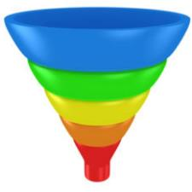
A tiered approach for an effective medical triage
Segregate based
on dose
Nuclear power plant accidents
Improvised Nuclear Devise
Radiation Dispersal Device
Tier I: Rapid screening
Reliable, sensitive
Low false positive
markers
< 2Gy
“Go Home”
[Prodromal symptoms
Hemodose
Transcriptomics
EPR]
(further monitoring
if any symptoms observed
2 Gy
Goiania
Tier I
130,000
Tier II: Cytogenetic
validation
> 2Gy
Medical
Intervention
110
Tier II
Long-term monitoring

Slide 40
Future Considerations
Current biodosimetry assays are based mainly on acute low LET radiation
Application of existing dose assessment methodologies to various exposure scenarios:
internal contamination through ingestion or inhalation of radionuclides, accumulated
fractionated exposures and mixed radiation qualities
Dose estimates need to be tested in models involving combined injury as inflammatory
response and trauma associated biological pathways may complicate evaluation of
“Omics” biomarker expression and dose
Bioindicators/biomarkers should be useful for predicting and monitoring ARS
The existing biodosimetry methods need to be modeled for special populations with
preexisting disease states, radiosensitivity due to genetic status, elderly and
pediatric populations
Development of critical organ specific biomarkers will be useful for long-term monitoring of effects. Discovery of organ specific therapeutics is desirable.

Slide 41
Contd…….
As appropriate human models of radiation exposure are limited, validation of biodosimetry methods needs to be performed in radiotherapy patients
Lymphocyte depletion kinetics and cytogenetic assays are considered to have the capacity for operational use for clinical diagnostics
The existing emergency management CONOPS for radiological event planning needs to be integrated with biodosimetry methodologies for developing POC tools for field use
Attempts should be made to determine the correlation between estimated absorbed dose and potential biological effects of radiation exposure
Knowledge in gap exists between biodosimetrists and physicians. Scientists must provide the kind of information physicians actually need for medical intervention!

Slide 42
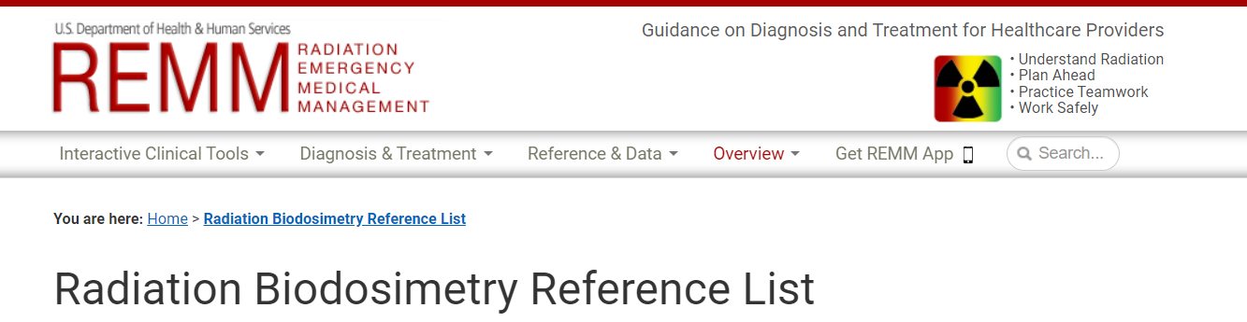
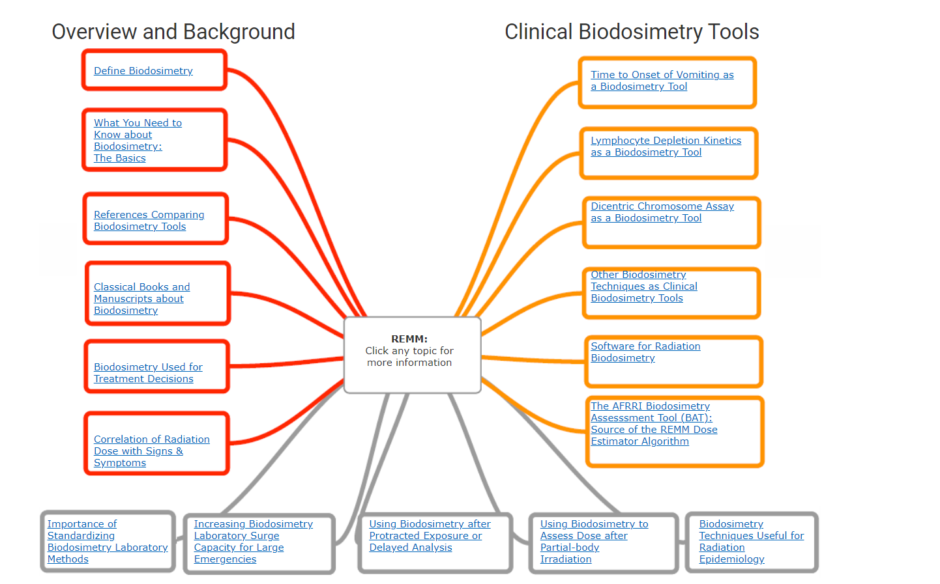

Slide 43





Acknowledgements
REAC/TS
Terri Ryan
Maria Escalona
Dr. Carol J. Iddins (Director)
Dr. Mark Ervin (Associate Director)
Columbia University Medical Center
Dr. Guy Garty
Dr. David J. Brenner
Yale University Medical Center, CT
Dr. Joseph Albanese
Ohio State University
Dr. Naduparambil Jacob
Oak Ridge National Laboratory
Dr. John Cahill

Slide 44
Questions???

